Slide 1
CUDA programming Performance considerations (CUDA best practices)
NVIDIA CUDA C programming best practices guide
ACK: CUDA teaching center Stanford (Hoberrock and Tarjan).

Slide 2
Outline
Host to device memory transfer
Memory Coallescing
Variable type performance
Shared memory bank conflicts
Control flow divergence
Occupancy

Slide 3
Host/device memory transfer
Should always be minimized
GPU device memory bandwidth 100’s GB/s
PCIe bandwidth 4-16 GB/s
Start-up overheads: large transfer is more efficient than multiple small transfers
Pinned (page-lock) memory:
cudaHostAlloc to allocate such memory
Memory that is always in physical memory
Can achieve highest bandwidth between host and device
Use as caution (reduce physical memory size).

Slide 4
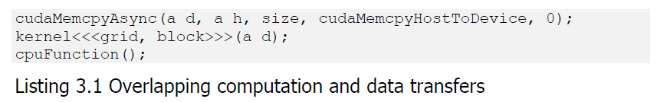
Host/device memory transfer
Asynchronous transfer and Overlapping memory copy with computation

Slide 5
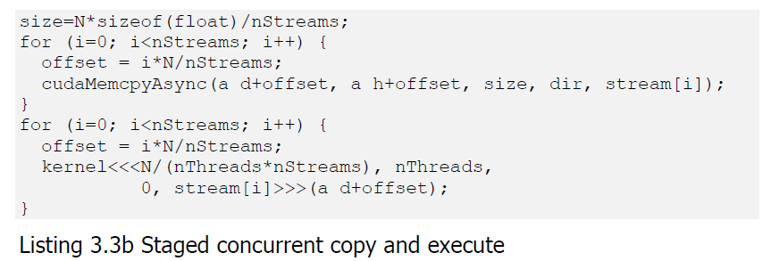
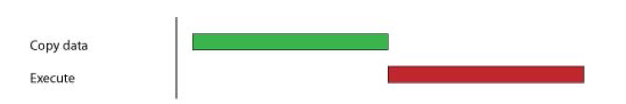

Host/device memory transfer
Staged concurrent copy and execute

Slide 6
Memory coalescing
Off-chip memory is accessed in chunks
Even if you read only a single word, they whole chunk still come in.
Chunks are aligned to multiples of 32/64/128 bytes
Example: threads 0-15 access 4-byte words at addresses 116-176
Will bring in two chunks 0-127 and 127-255.
256-64 = 192 bytes are wasted.

Slide 7
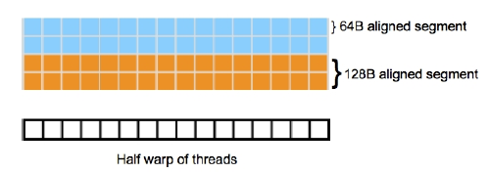
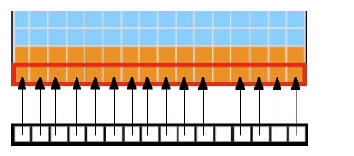
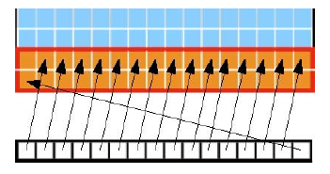
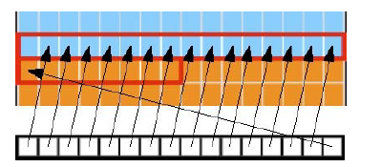
Memory coalescing
Aligned and misaligned device memory accesses

Slide 8
Memory coalescing
Aligned memory access .vs. unaligned memory access.
Always try to align the memory and operate on the whole chunk
Sequence access .vs. stride access
For (i=0; i<n; i++) {… = a[i];} // sequence access
For (i=0; i<n; i++) { … = a[2*i];} // stride access
Use sequence access as much as possible.

Slide 9
Memory coalescing
Array of structure .vs. structure of array
Struct record { struct record {
int key; int *key;
int value; int *value;
int flag; int *flag;
}; };
Record myrecord[100]; record myrecord;
__global__ void foo (….)
{ int I = blockDim.x * blockIdx.x + threadIdx.x;
int key = myrecord[i].key; or int key = myrecord.key[i];
}

Slide 10
Memory coalescing
Array of structure .vs. structure of array
Structure of array is often better than array of structures
Clear win for sequence access.
Unpredictable for irregular access pattern.

Slide 11
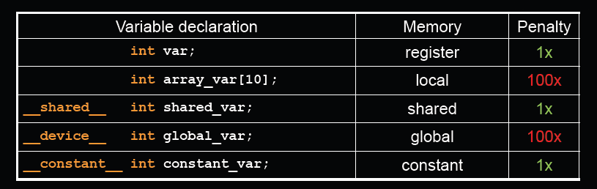
CUDA variable type performance
Local variables and globals in uncached off-chip memory
Constant variable in cached off-chip memory
Use register, shared, and constant as much as possible.

Slide 12
Shared memory bank conflicts
Shared memory is banked
GTX 480 has 32 banks, each bank can read 32 bits in 2 cycles.
Total shared memory bandwidth: 4 * 32 * 0.5 * 1400M * 15 = 1.33TBs
Only matters for threads within a warp
Full performance when
Threads access different banks
Consecutive words are in different banks
If two or more threads access the same bank but different values, get bank conflicts.

Slide 13
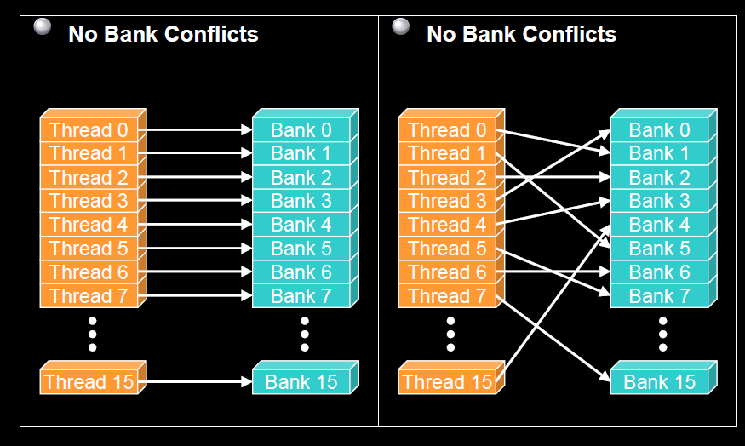
Examples: no bank conflicts

Slide 14
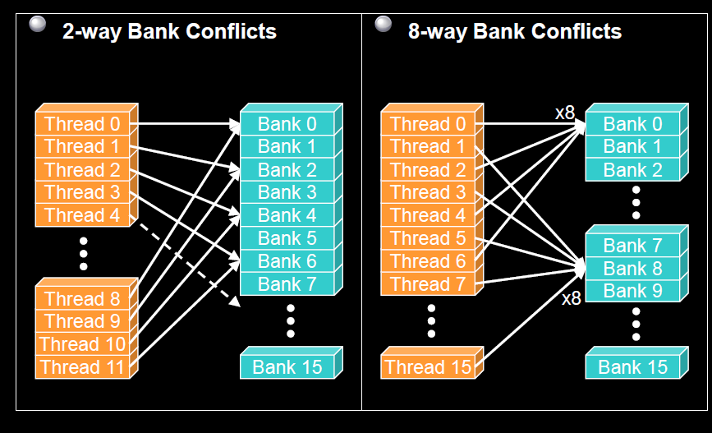
Example: bank conflicts

Slide 15
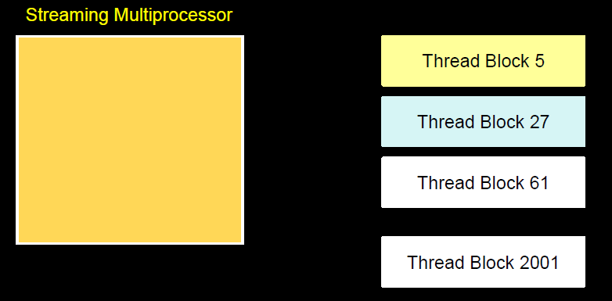
Thread scheduling and control flow divergence
HW schedules thread blocks onto available SMs
No guarantee of ordering
HW will schedule thread blocks as soon as a previous thread block finishes.

Slide 16
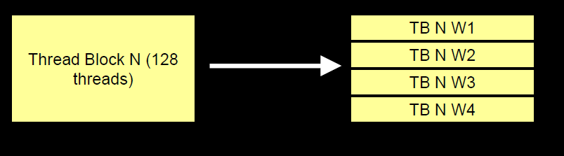
Mapping of thread blocks
Each thread block is mapped to one or more warps
Warps are scheduled independently.

Slide 17
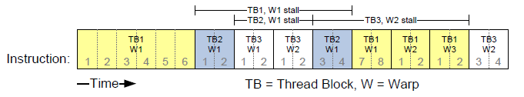
Thread scheduling
SM supports zero-overhead warp scheduling
At any time only one warp is executing on one SM
Warp whose next instruction has its inputs ready are eligible for execution
Eligible warps are selected with a prioritized scheduling policy
All threads in a warp execute the same instruction when selected.

Slide 18
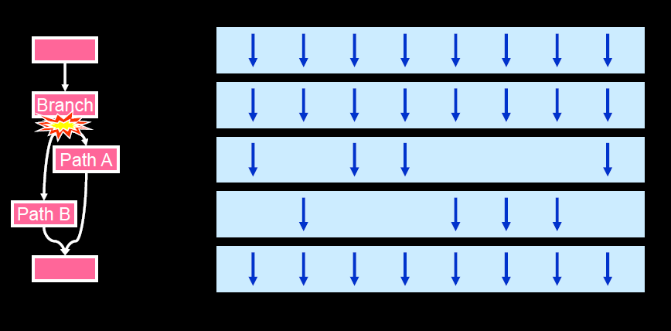
Control flow divergence
What happen if we have an if statement?

Slide 19
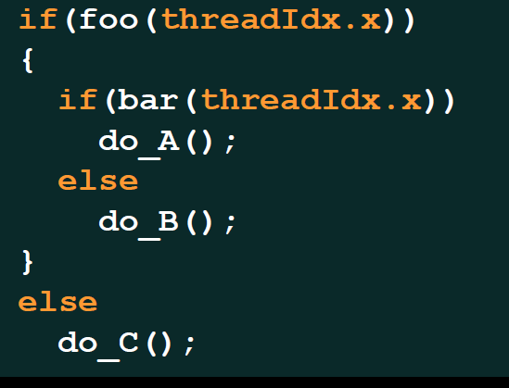
More complicated branches?

Slide 20
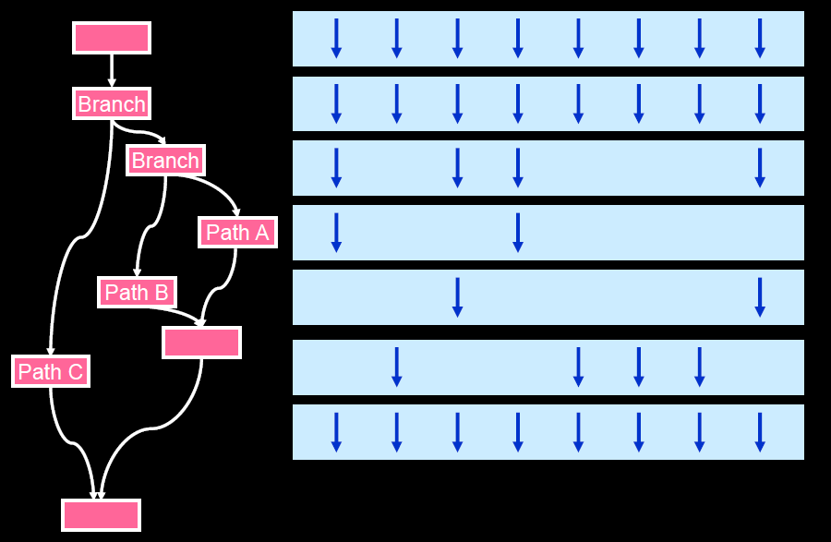
More complicated branches?

Slide 21
Control flow divergence
Due to SIMT, you don’t need to worry about correctness.
You will need to consider this for performance
Performance drops off with the degree of divergence.
Avoid diverging within a warp:
Branch with divergence:
If (threadIdx.x > 2) {…}
Else { … }
Branch without divergence
if (threadIdx.x /WARP_SIZE > 2) { …}
Else {…}
Branch granularity is a multiple of warp size.

Slide 22
Compute capability and occupancy
NVIDIA define compute capability that gives resources limitations for its devices
Run devicequery.cu to see the GPU properties.
Resources limit the number of warp/threads that can be executed simultaneously on SMs.

Slide 23
Occupancy
Warps are stalled all the time (load/store to global memory).
If all warps are stalled, no instruction is issued.
Needs a lot of warps to keep SM busy.
Maximizing the number of warps in an SM is very important (also called maximize occupancy).

Slide 24
What determines occupancy?
Each SM has limited registers and shared memory
Register and shared memory usage per thread will determine the occupancy.
Hard limit of the number of thread blocks in each SM (8).

Slide 25
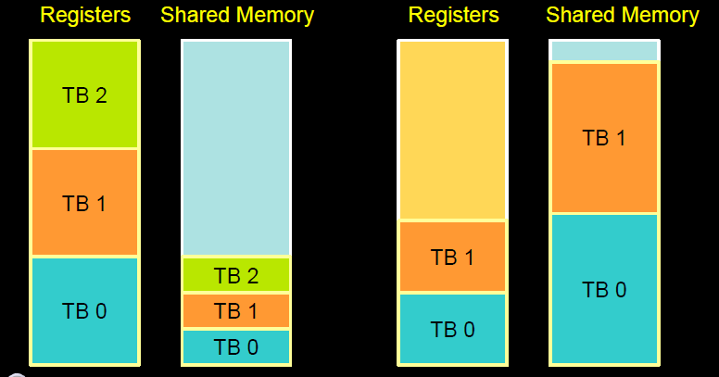
Resource limits (1)
Pool of registers and shared memory per SM
Each thread block grabs some resources
If one or the other is fully utilized, no more thread blocks.

Slide 26
Resource limits (2)
Can only have 8 thread blocks per SM
If thread blocks are too small, they cannot fully utilize the SM
Need at least 128/256 threads/block
The number of threads per block should always be a multiple of 32.
Higher occupany has diminishing return for hiding latency.

Slide 27
How do you find out the register and shared memory usage
Use ‘nvcc –Xptxas –v a.cu’ to get register and shared memory usage.
You can plug the number to CUDA occupancy calculator to see the occupancy.
Google ‘CUDA occupancy calculator’
To change the register usage: use flag
-maxrregcount=X
This can significant affect the program performance as some register is now in memory.

